Slide 1
Data 100 Discussion 5: Data Visualization
Vikram Sreekanti
2/20/2020

Slide 2
Types of Data
Quantitative
Continuous: Infinitely many values (e.g., latitude/longitude, distance)
Discrete: Finite number of values (e.g., # of classes taken)
Visualized with histograms, box plots, rug plots, etc.
Qualitative:
Nominal: Unordered categories (e.g., color, school attended)
Ordinal: Ordered categories (e.g., places in a race)
Visualized with bar charts or other categorical separators (e.g., problem 1 on the discussion worksheet)

Slide 3
What plots should I use?
There’s no right answer!
Univariate data
Continuous: Histograms, density curves, box/violin plots, rug plots
Discrete: Bar chart, pie chart
Bivariate data
Numerical: scatter plot, contour plot
Categorical + Numerical: Small multiples of histograms
Categorical: Small multiples of bar chart, dot chart

Slide 4
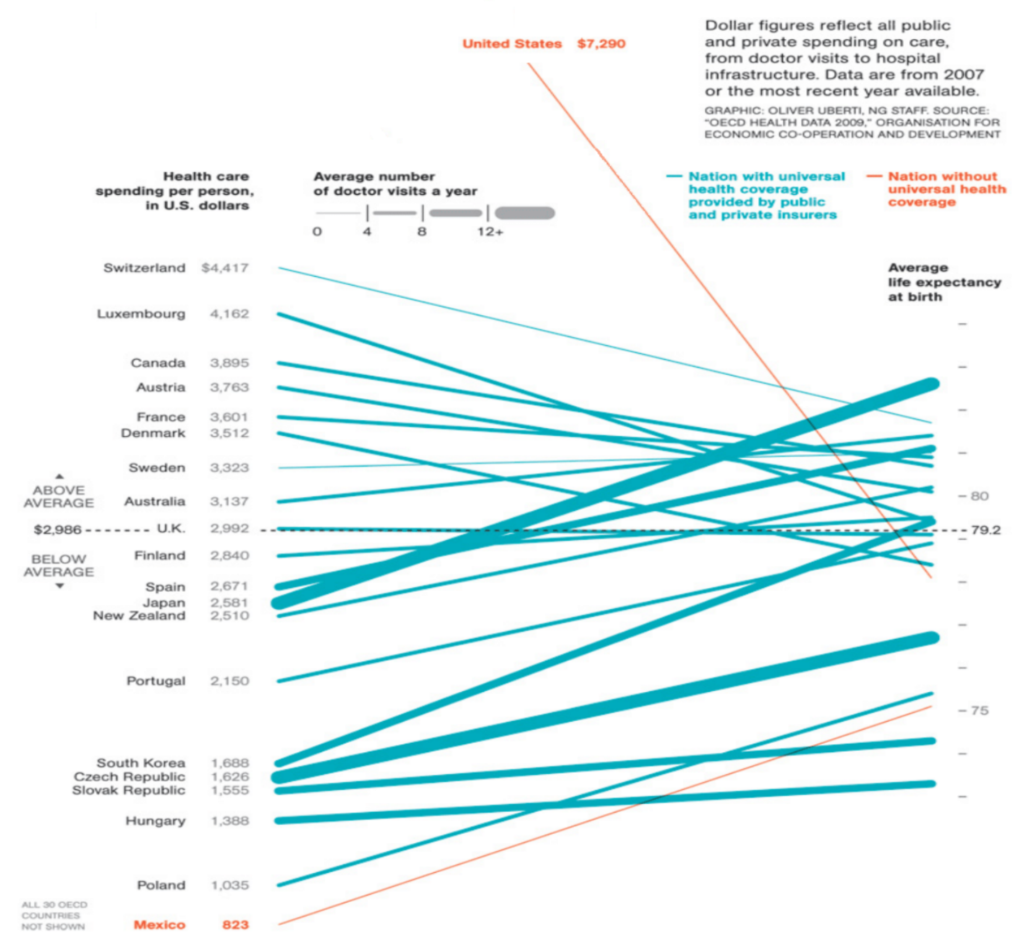
Part 1: Healthcare Spending
Five variables are being represented visually in this graphic. What are they and what are their types?

Slide 5
Part 1: Healthcare Spending
Five variables are being represented visually in this graphic. What are they and what are their types?
Country: nominal
Spending: continuous
Visits per year: discrete
Coverage status: nominal
Life expectancy: continuous

Slide 6
Part 1: Healthcare Spending
How are the variables represented?
Notes:
1. ”Country” appears as labels for the line segments (on the left y-axis)
2. ”Healthcare spending per person in USD” is mapped to the y-axis on the left. It increases vertically.
3. ”Average number of doctor visits per year” is presented as the thickness of the line connecting ”healthcare spending per person in USD” to ”average life expectancy at birth”. The variable has been discretized.
4. ”Universal health coverage status” is presented through the color of the line segment.
5. ”Average life expectancy at birth” is presented on the second y-axis (on the right). It increases vertically.

Slide 7
Part 1: Healthcare Spending
How can we figure out how to interpret the visual qualities of the plot, e.g., how do we know what a color represents?

Slide 8
Part 1: Healthcare Spending
How can we figure out how to interpret the visual qualities of the plot, e.g., how do we know what a color represents?
Left and right axes provide numerical measurements.
Color/thickness legend at top of graph.
Labels on left axis for country.

Slide 9
Part 1: Healthcare Spending
Make 3 observations about the figure. Describe the feature that you are basing your observation on.
Notes:
It provides information on the source and temporality of the data. This data was collected between 2007-2009. How much would you expect this visualization to change if we considered similar data from 2017-2019?

Slide 10
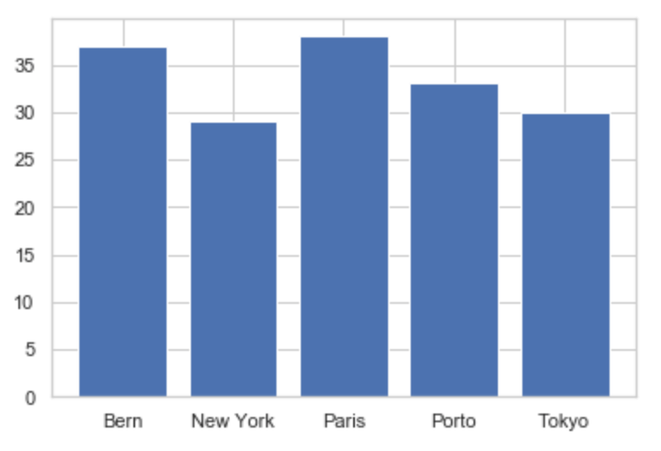
Part 2: Types of Graphs to Use
A) The distribution of populations for various cities.

Slide 11
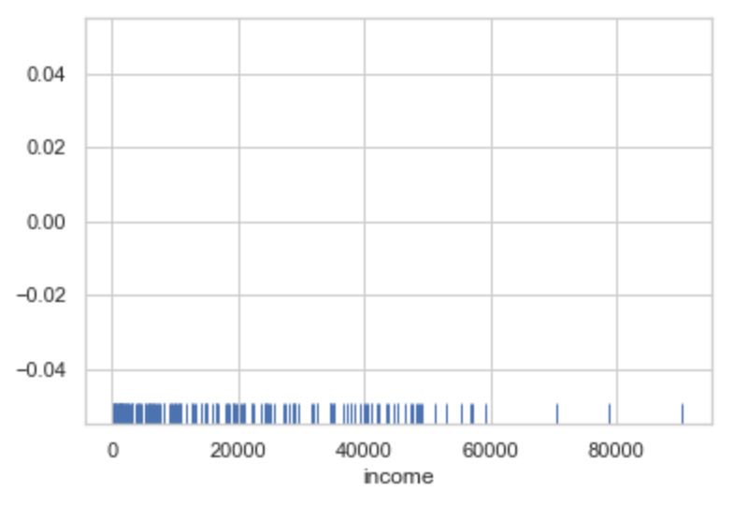
Part 2: Types of Graphs to Use
B) The distribution of income.

Slide 12
Part 2: Types of Graphs to Use
B) The distribution of income.

Slide 13
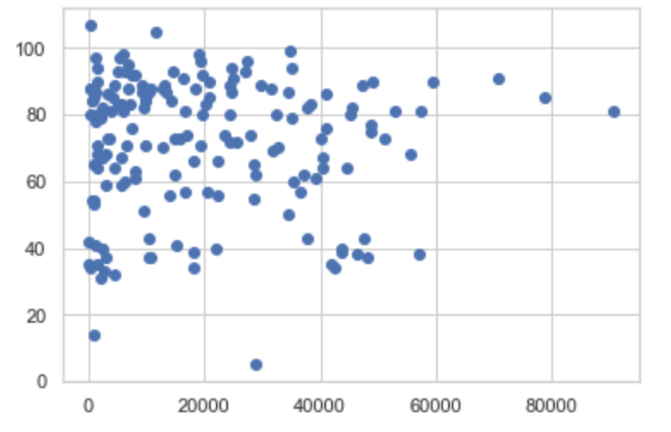
Part 2: Types of Graphs to Use
C) The relationship between income and life expectancy.

Slide 14
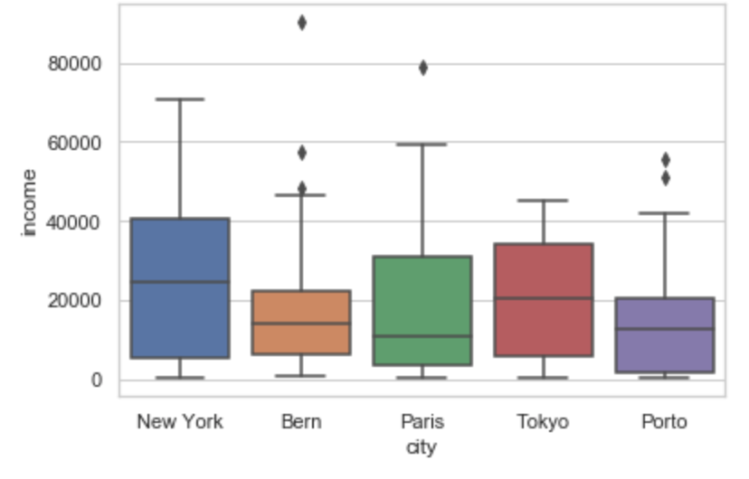
Part 2: Types of Graphs to Use
D) The relationship between income and city.

Slide 15
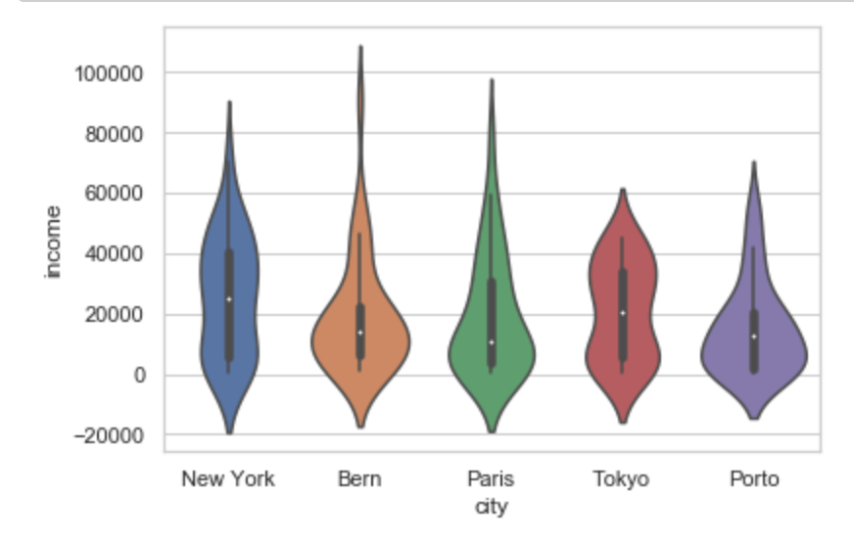
Part 2: Types of Graphs to Use
D) The relationship between income and city.

Slide 16
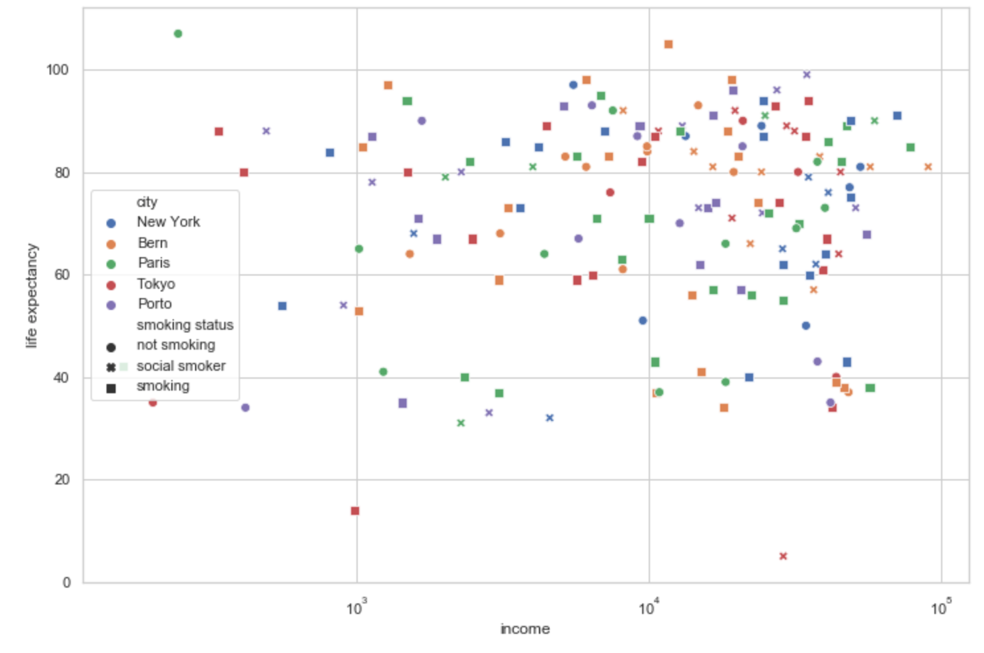
Part 2: Types of Graphs to Use
E) The relationship between income, life expectancy, smoking status(non-smoker, social smoker, smoker), and city

Slide 17
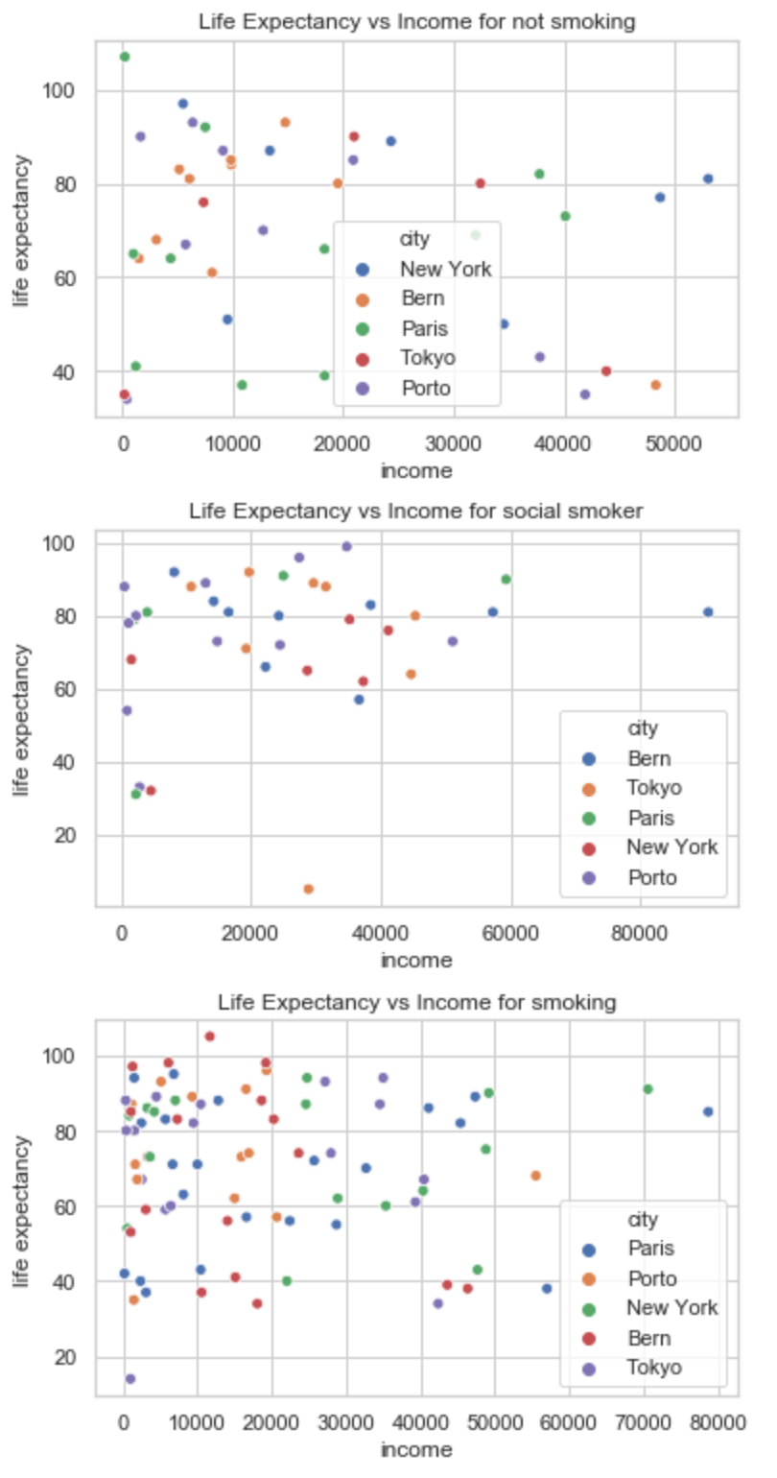
Part 2: Types of Graphs to Use
E) The relationship between income, life expectancy, smoking status(non-smoker, social smoker, smoker), and city

Slide 18
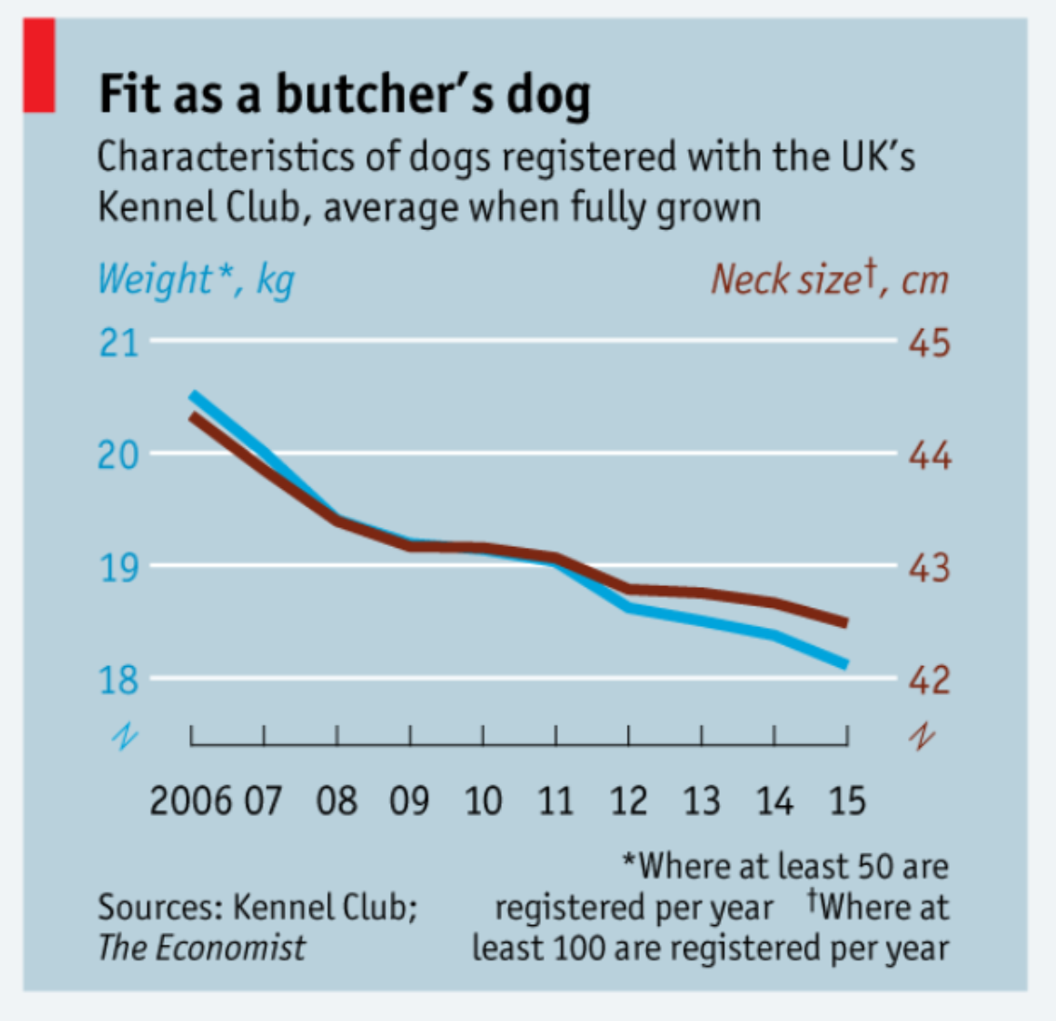
Part 3: Bad Visualizations
Though the scales on either side of the y-axis have the same increments (e.g. each tick mark corresponds to a change in one unit), they are not proportional. A change in weight from 20kg to 18kg corresponds to a 10% decrease in weight, but a decrease in neck size from 44cm to 42 cm roughly corresponds to a 4.5% decrease. The scales should be normalized to ensure a fair comparison.

Slide 19
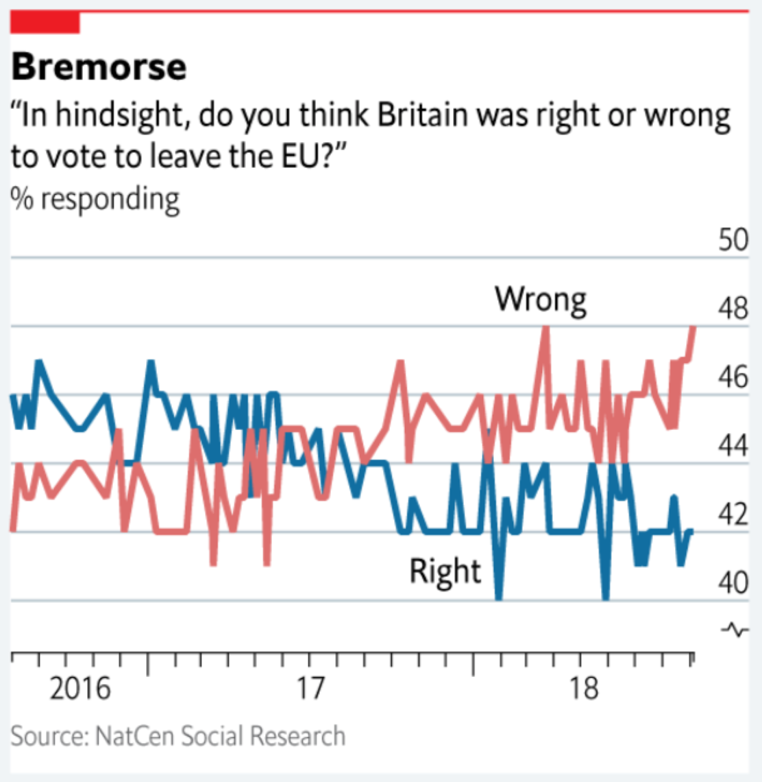
Part 3: Bad Visualizations
The plot is attempting to display the trend of Brexit remorse over time by plotting the exact survey results at each time-point. Smoothed lines would reduce the amount of visual noise and better support the claim that Brexit remorse is increasing.

Slide 20
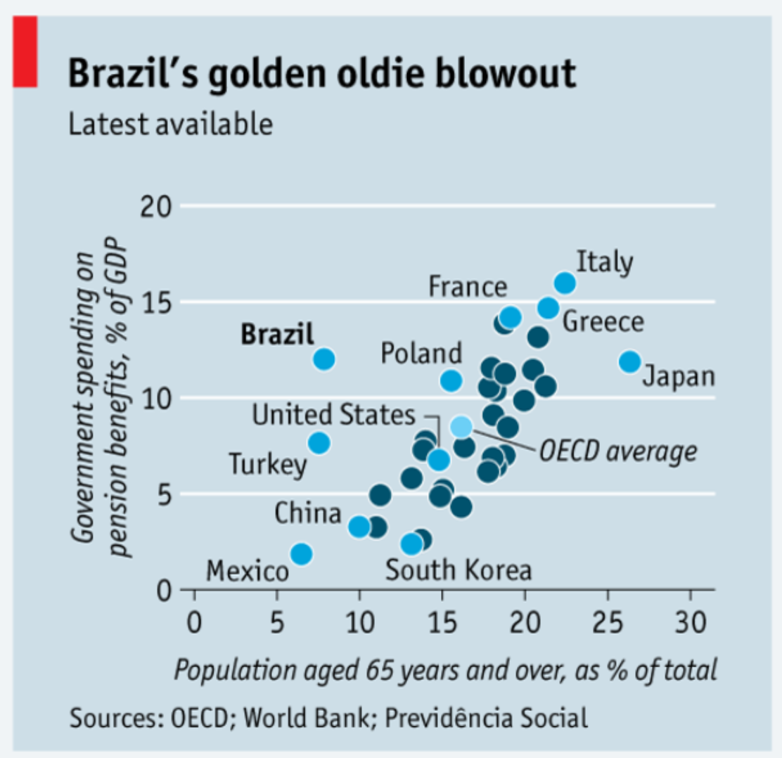
Part 3: Bad Visualizations
There a two main issues with this plot:
(a) The shade of blue used to color datapoints serves only to indicate whether the datapoint is labeled. Colors should be used to illustrate categorical variables.
(b) The inclusion a large number of labels contributes to the visual noise. Remov-
ing all but Brazil’s label would make for a cleaner plot, all while supporting the narrative. Keep it simple!

